Slide 1
Perspectives on AI and Machine Learning Lecture Series in Artificial Intelligence + Machine Learning

Slide 2
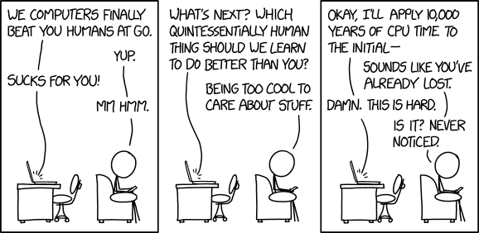
Topics Covered in Today’s Lecture
Latest Developments in AI/ML
Challenges & Risks in AI/ML
The Future of AI/ML?
https://xkcd.com/1875/

Slide 3
PART A
Latest Developments in AI/ML
https://twitter.com/hslu_aiml

Slide 4
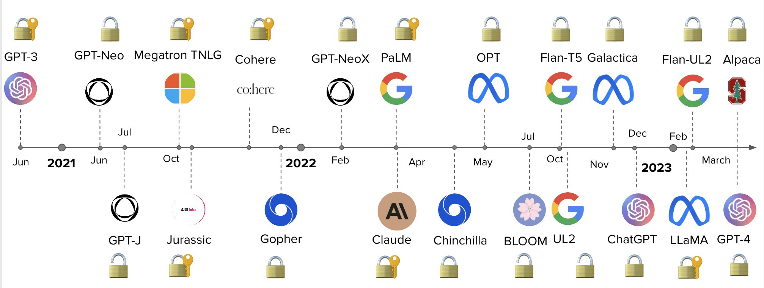
Latest Developments in Language Synthesis

Slide 5
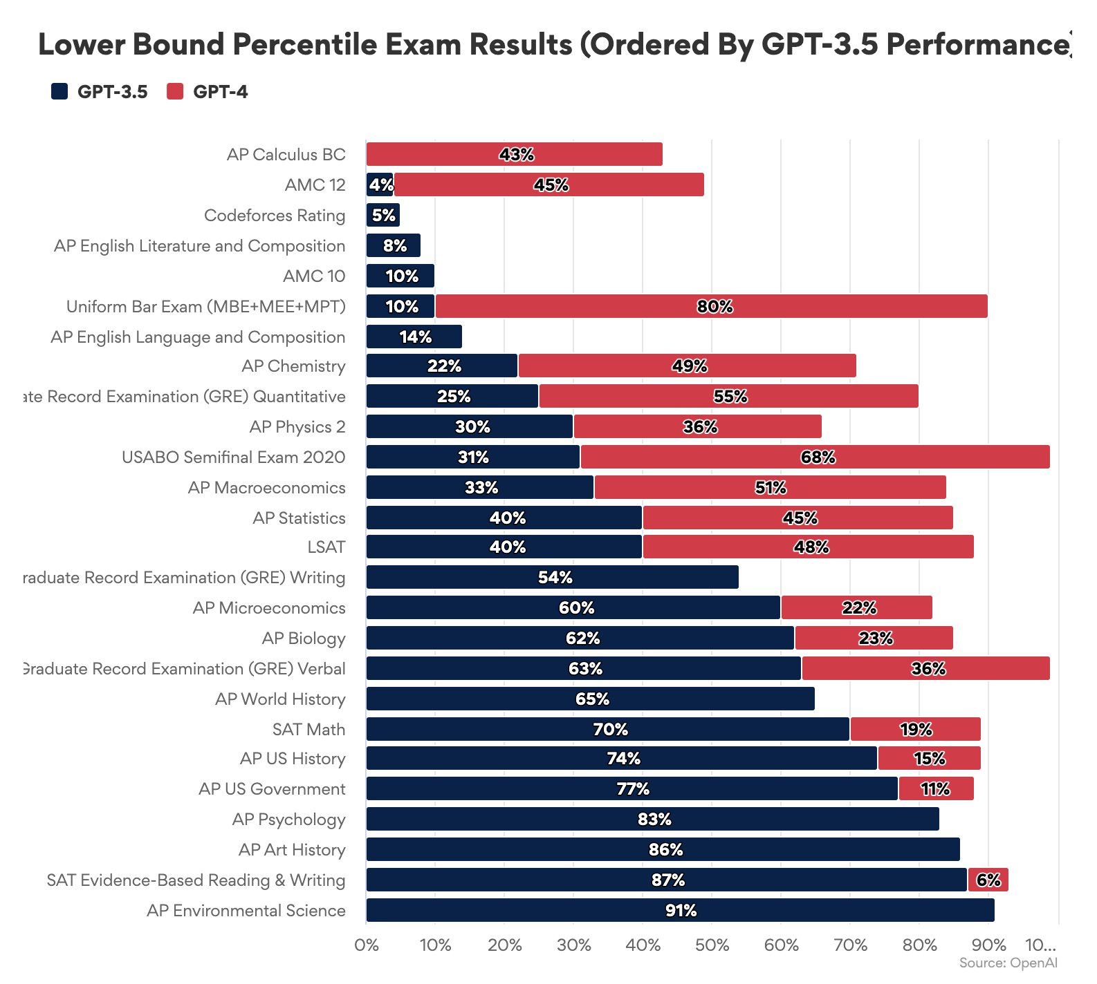
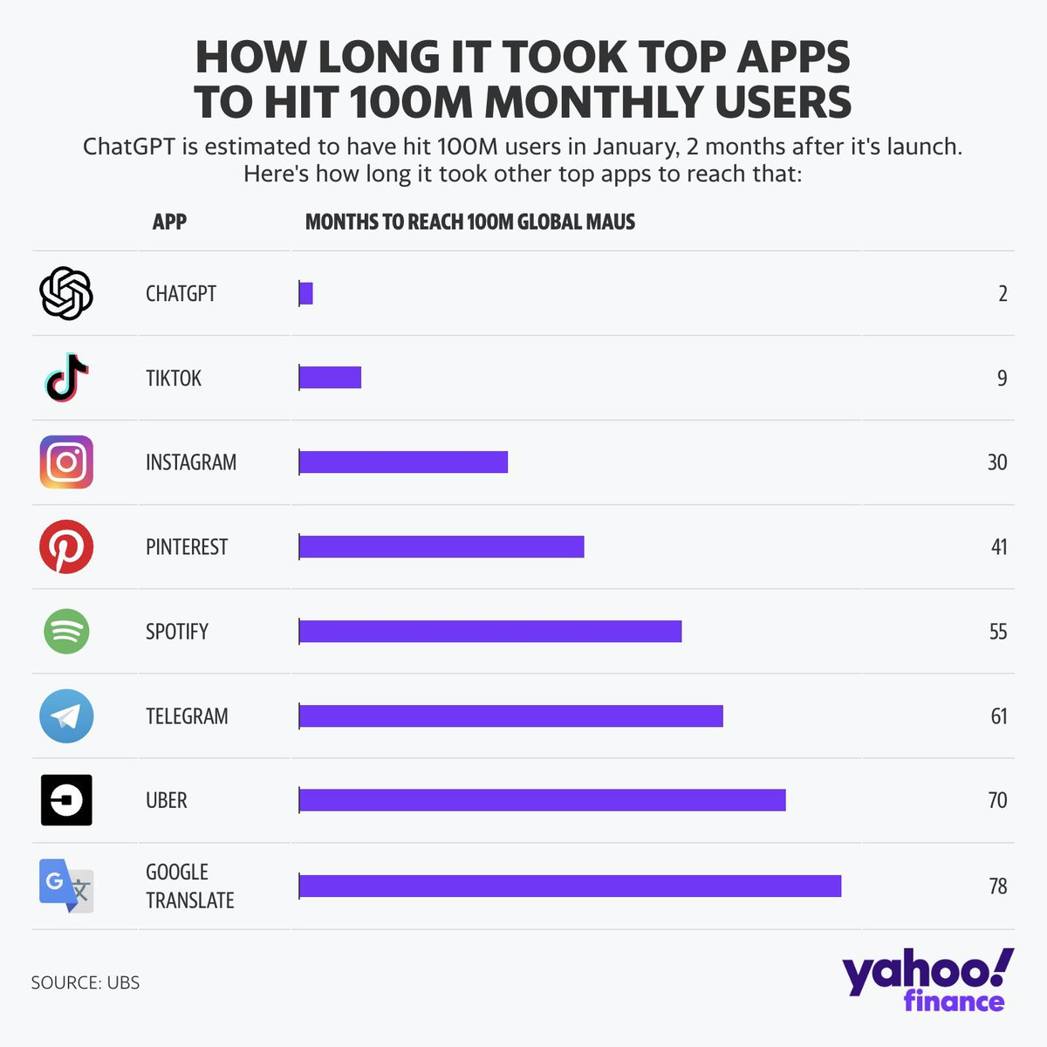
Latest Developments in Language Synthesis

Slide 6
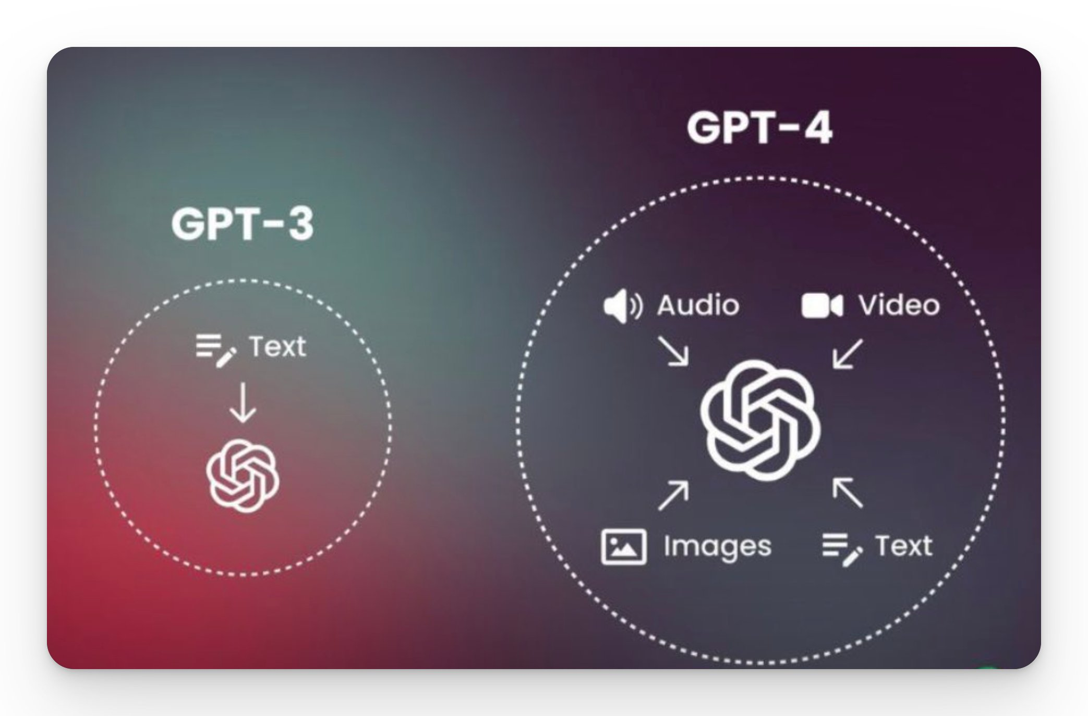

Latest Developments in Language Synthesis

Slide 7
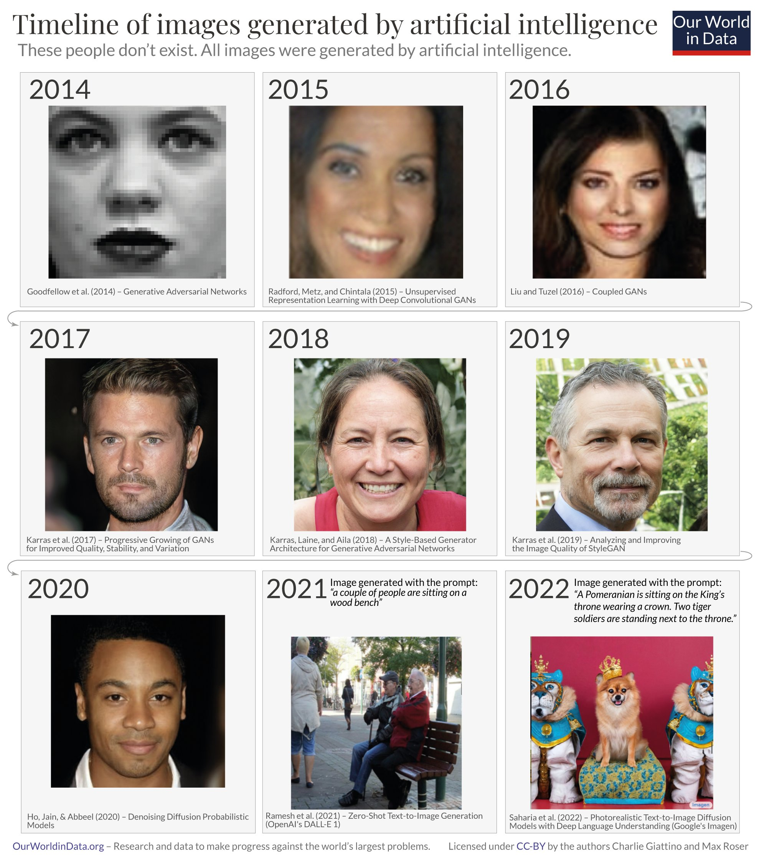

Latest Developments in Image Synthesis
Generative Adversarial networks (GANs)
Diffusion Models (Academic)
Diffusion Models (Commercial: Midjourney)
Mar 2022
Midjourney V1
Apr 2022
Midjourney V2
Jul 2022
Midjourney V3
Nov 2022
Midjourney V4
Mar 2023
Midjourney V5
https://twitter.com/haroonchoudery/status/1638297476758372353
https://twitter.com/pmigdal/status/1637047570768830465

Slide 8

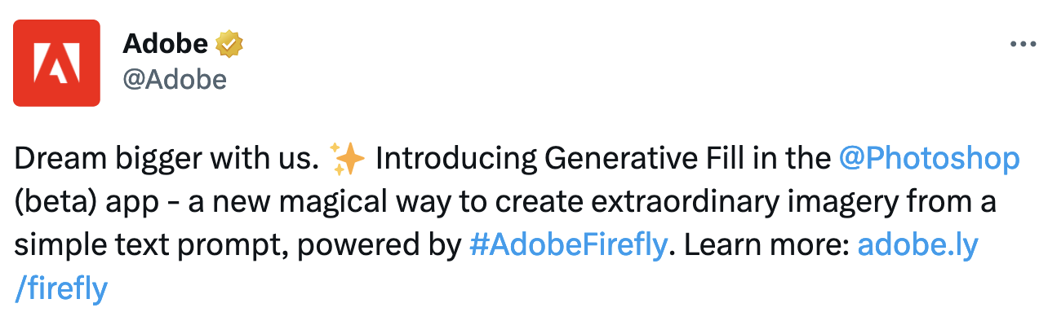
Latest Developments in Image Synthesis

Slide 9

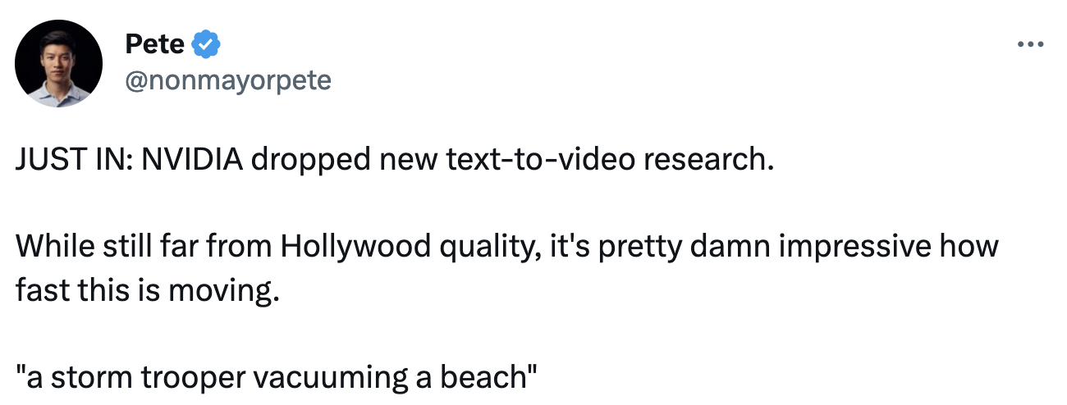
Latest Developments in Video Synthesis

Slide 10
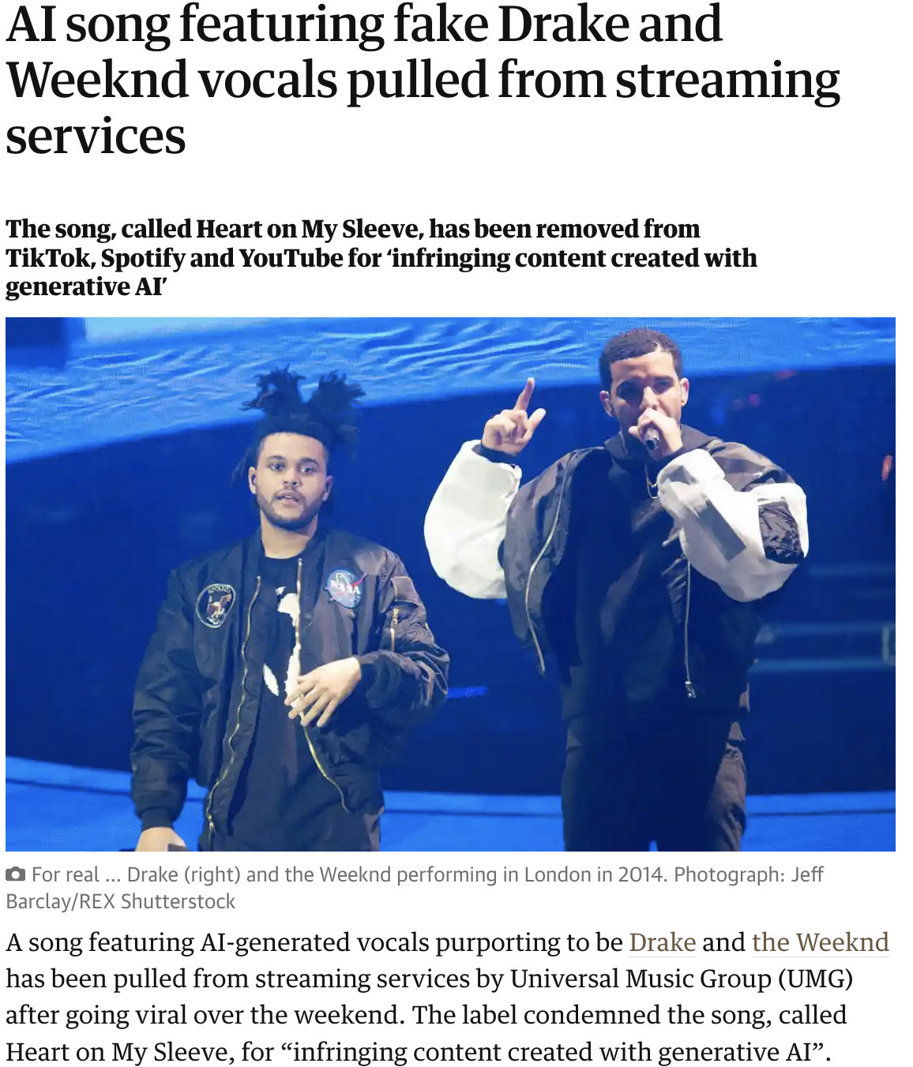
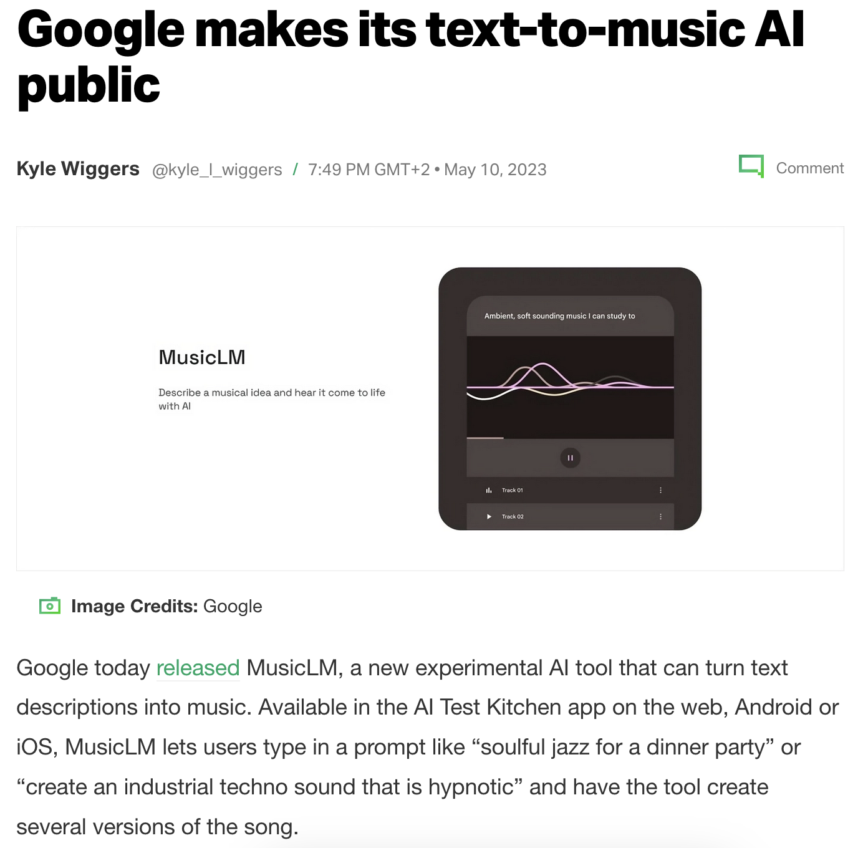
Latest Developments in Music Synthesis

Slide 11

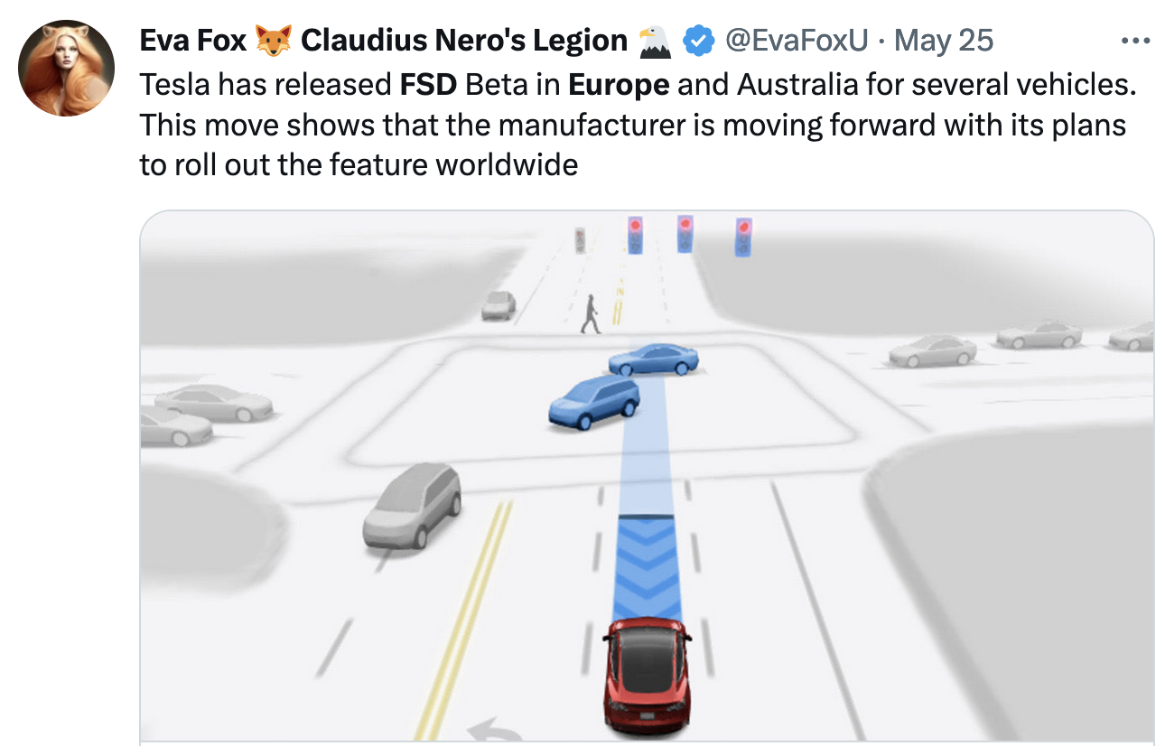
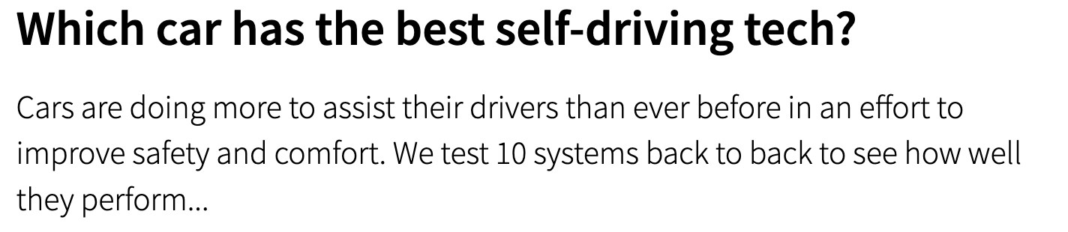
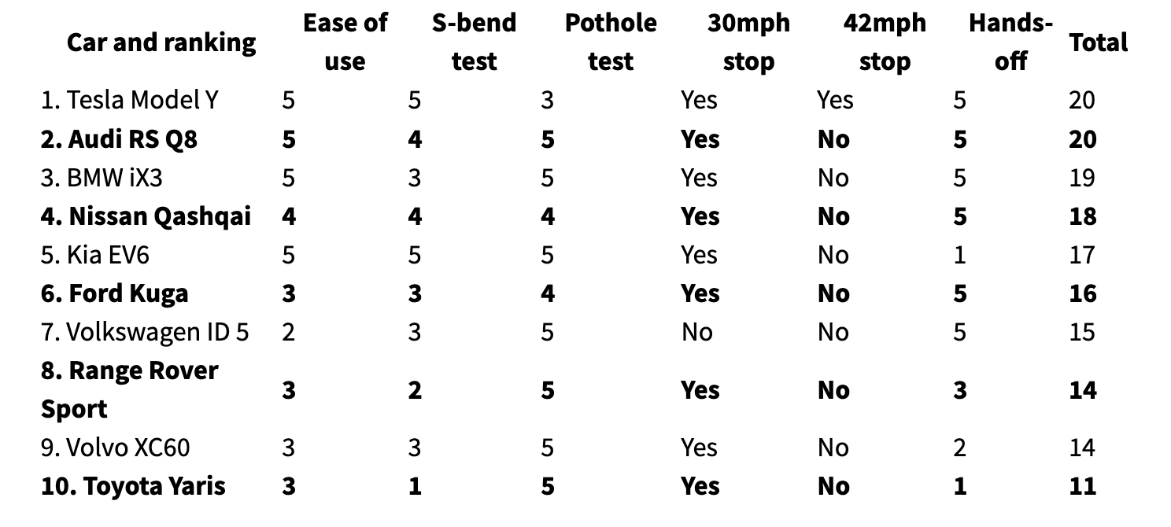
Latest Developments in Autonomous Systems

Slide 12

Latest Developments in Autonomous Systems

Slide 13
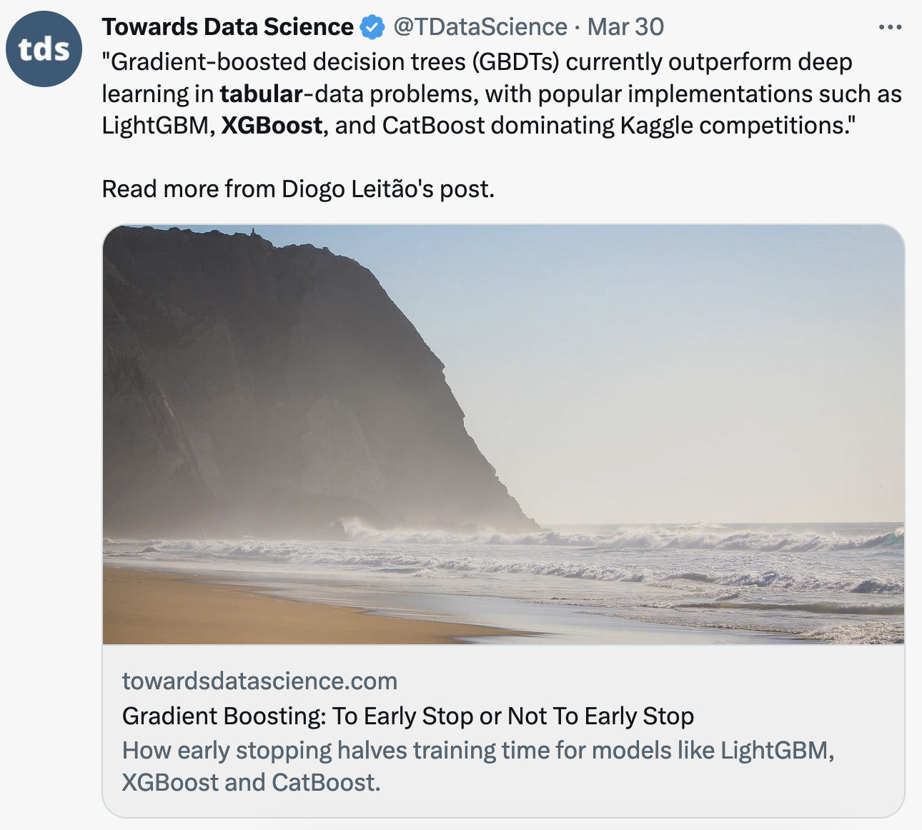
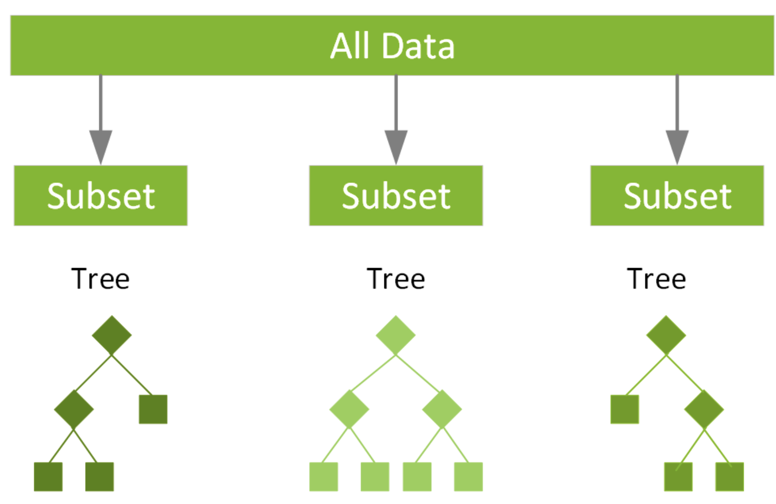
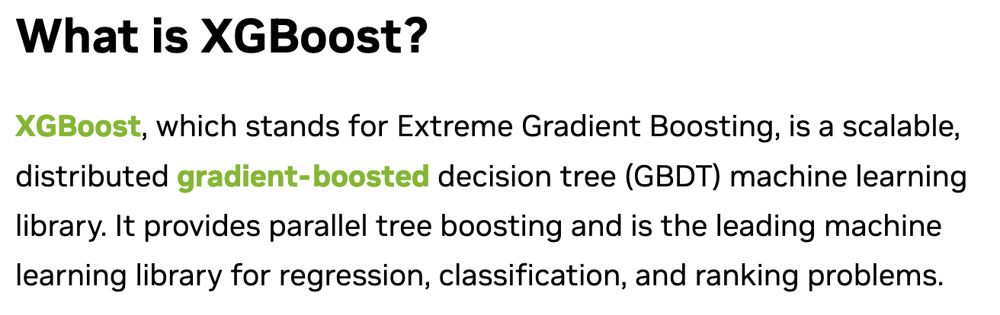
Latest Developments in Data Science

Slide 14
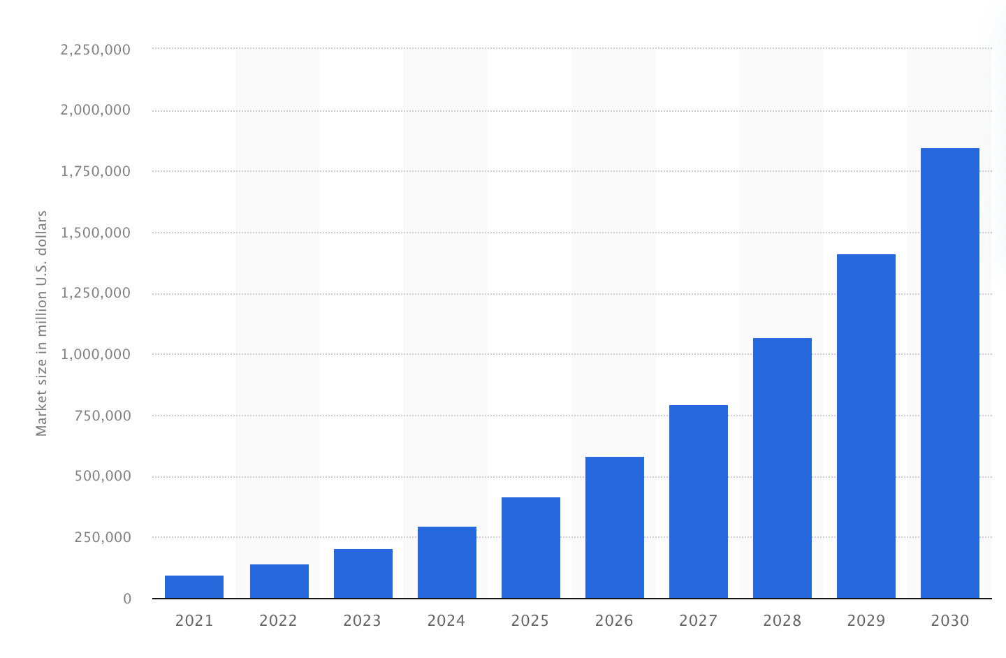
Latest Developments in AI Investment
Global artificial intelligence market size 2021-2030
(May 2023)
According to Next Move Strategy Consulting the market for artificial intelligence (AI) is expected to grow from nearly 100 billion U.S up to nearly two trillion U.S. dollars.
The AI market covers a vast amount of industries. Everything from supply chains, marketing, product making, research, analysis, and more are fields that will in some aspect adopt artificial intelligence within their business structures.

Slide 15
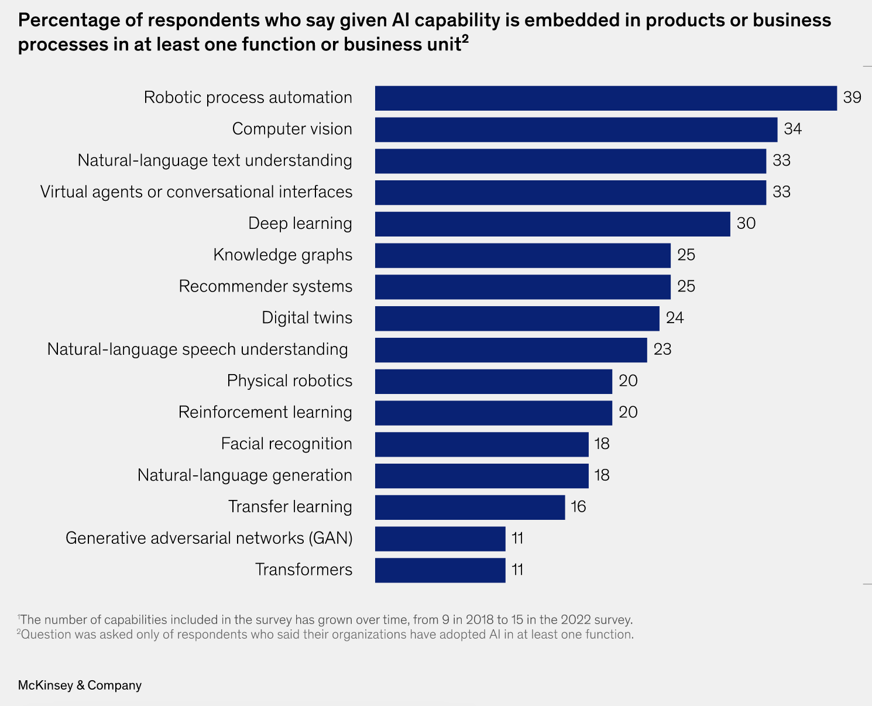
Latest Developments in AI Investment
This McKinsey AI survey was conducted in the field from May 3 to May 27, 2022, and from August 15 to August 17, 2022, and garnered responses from 1,492 participants representing the full range of regions, industries, company sizes, functional specialties, and tenures. Of those respondents, 744 said their organizations had adopted AI in at least one function and were asked questions about their organizations’ AI use.
https://www.mckinsey.com/capabilities/quantumblack/our-insights/the-state-of-ai-in-2022-and-a-half-decade-in-review#research

Slide 16
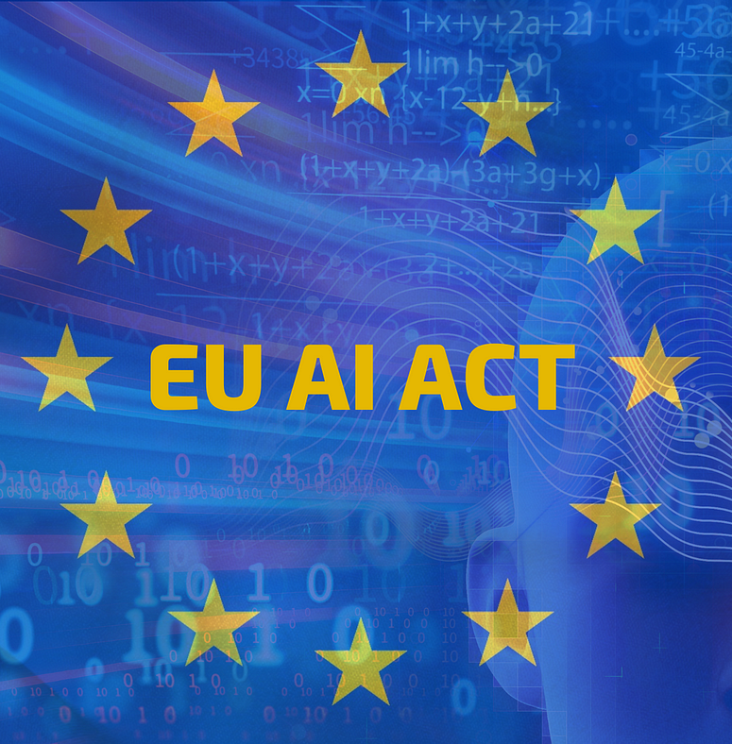
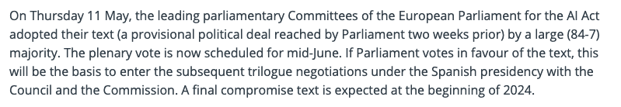
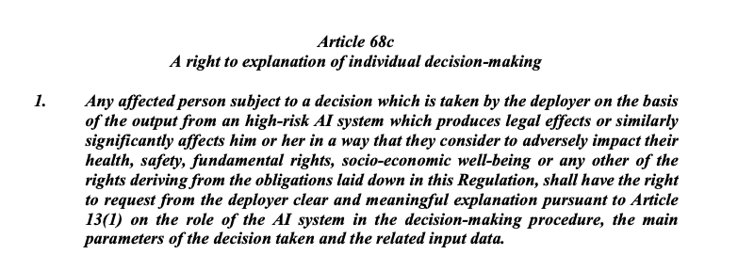
Latest Developments in AI Regulation

Slide 17
PART B
Challenges & Risks in AI/ML

Slide 18
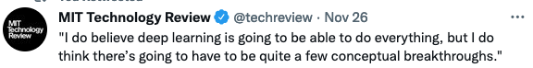
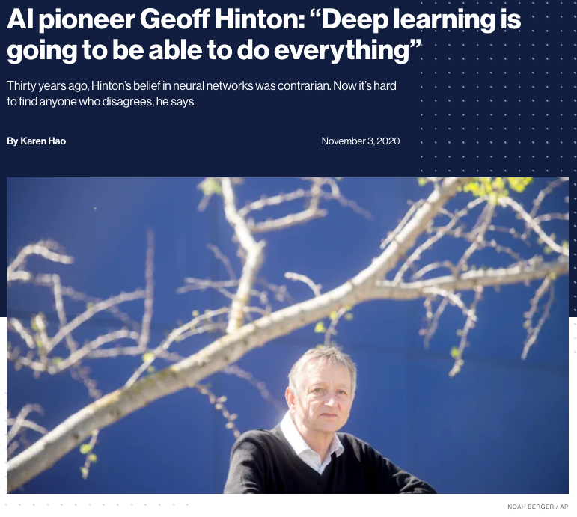
The Hype Around AI
https://www.technologyreview.com/2020/11/03/1011616/ai-godfather-geoffrey-hinton-deep-learning-will-do-everything

Slide 19
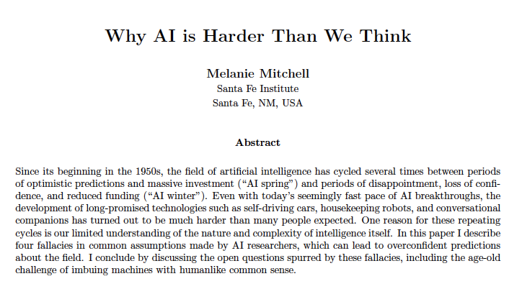

We are wrong about AI in many ways
Narrow intelligence is on a continuum with general intelligence: No!
Easy things are hard and hard things are easy (e.g. picking up a box v beating a grandmaster at chess): No!
Machine learning resembles learning in humans (pursuit of a goal, understanding data): No!
Intelligence is all in the brain (the body is not central to cognitive activities): No!
Melanie Mitchell is a professor of computer science at Portland State University. She has worked at the Santa Fe Institute and Los Alamos National Laboratory. Her major work has been in the areas of analogical reasoning, complex systems, genetic algorithms and cellular automata.
https://arxiv.org/abs/2104.12871

Slide 20

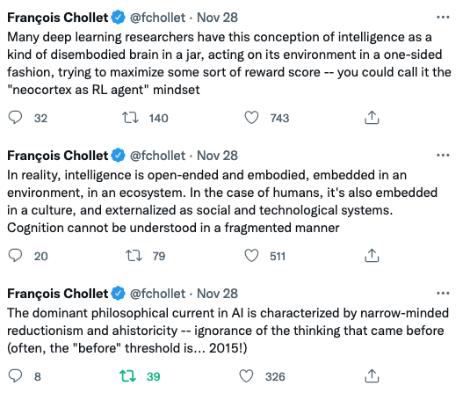

AI Cannot be a “Brain in a Jar”
https://twitter.com/fchollet/status/1464875867587424256

Slide 21
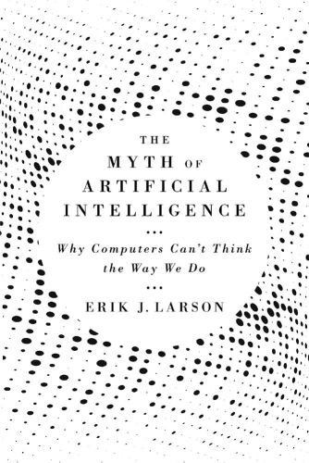
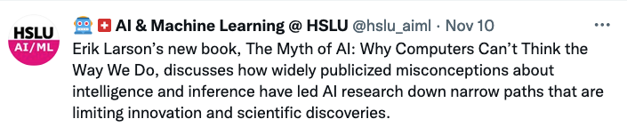
AI doesn’t do “Common Sense”
https://bdtechtalks.com/2021/09/20/myth-of-artificial-intelligence-erik-larson/

Slide 22
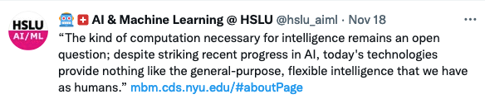

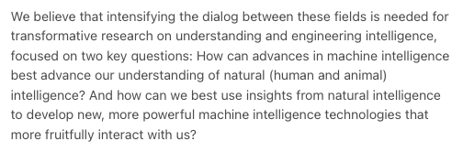
We are far from Human-like AI
https://mbm.cds.nyu.edu/#landingPage

Slide 23
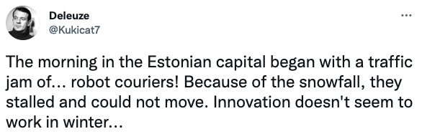
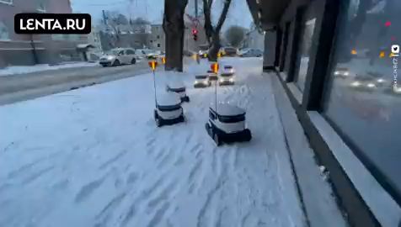

Generalization is Hard
https://twitter.com/Kukicat7/status/1466328532250943491

Slide 24
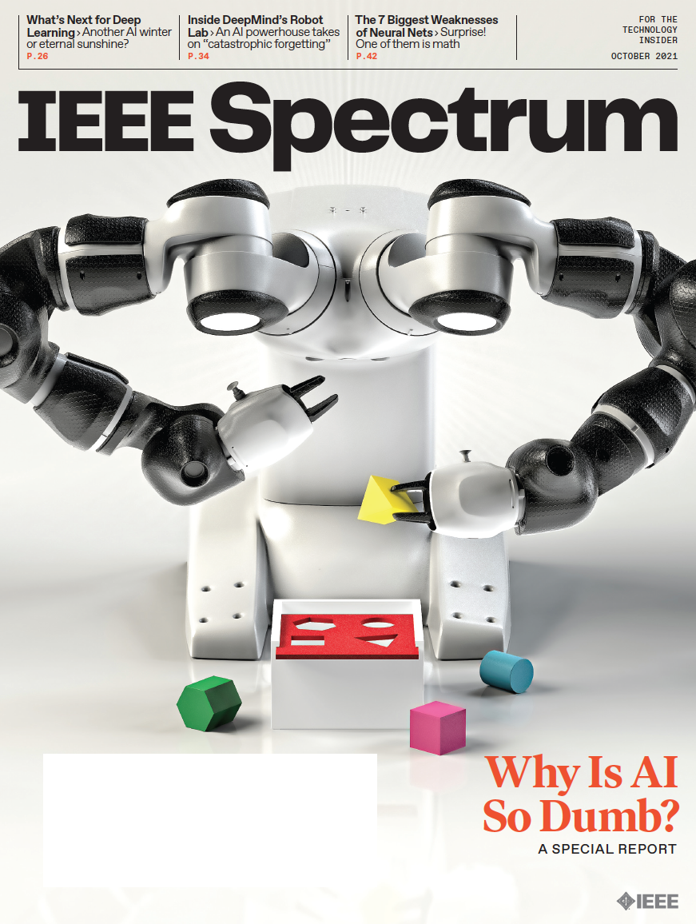
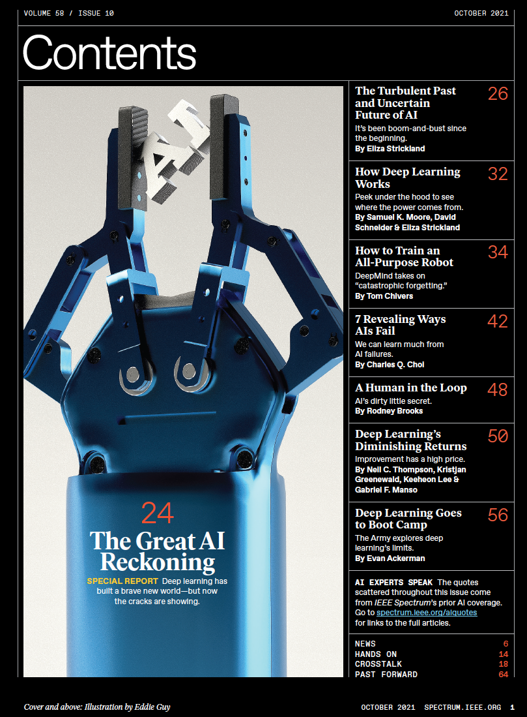

October 2021

Slide 25

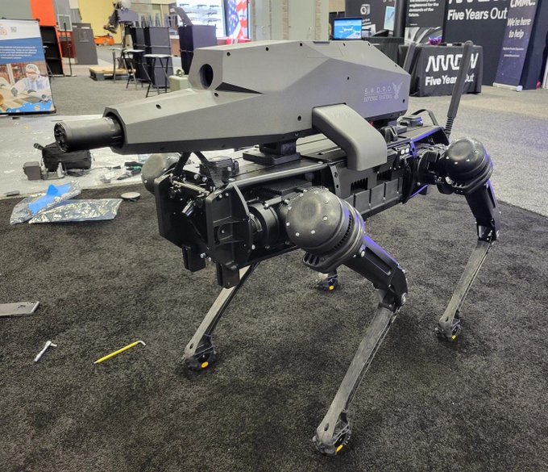
Not just Dumb but Dangerous
https://twitter.com/verge/status/1448661683530977295

Slide 26
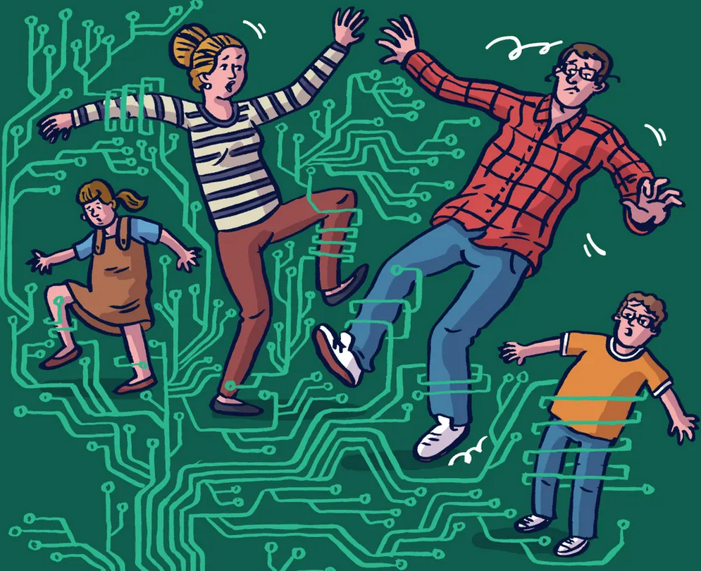
Misuse of ML is Undermining Democracy
What we have discovered since 2016 is that the micro-targeting enabled by ML algorithms deployed by social media companies has weakened or undermined some of the institutions on which a functioning democracy depends.
It has, produced a polluted public sphere in which mis- and disinformation compete with more accurate news.
And it has created digital echo-chambers and led people to viral conspiracy theories such as Qanon and malicious content orchestrated by foreign powers and domestic ideologues.
https://www.theguardian.com/technology/2020/sep/06/from-viral-conspiracies-to-exam-fiascos-algorithms-come-with-serious-side-effects?CMP=Share_iOSApp_Other

Slide 27
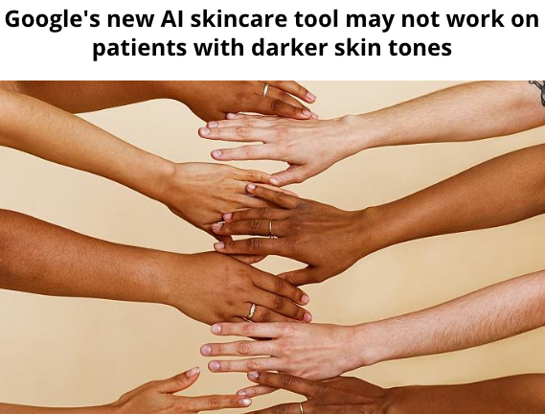
Lack of Diversity is a Real Problem
https://www.euronews.com/2021/05/26/google-s-new-ai-skincare-tool-may-not-work-on-patients-with-darker-skin-tones

Slide 28

Training large deep-learning models is highly energy intensive
In 2019 researchers at Uni. Amherst estimated that training one version a big language model, could cost as much as $3m.
Facebook’s head of AI, says that one round of training for the biggest models can cost “millions of dollars” in electricity consumption.
In 2020 an algorithm capable of learning, through trial and error, how to manipulate the pieces of a Rubik's Cube using a robotic hand consumed about 2.8 gigawatt-hours of electricity in its training
https://www.wired.com/story/ai-great-things-burn-planet/

Slide 29
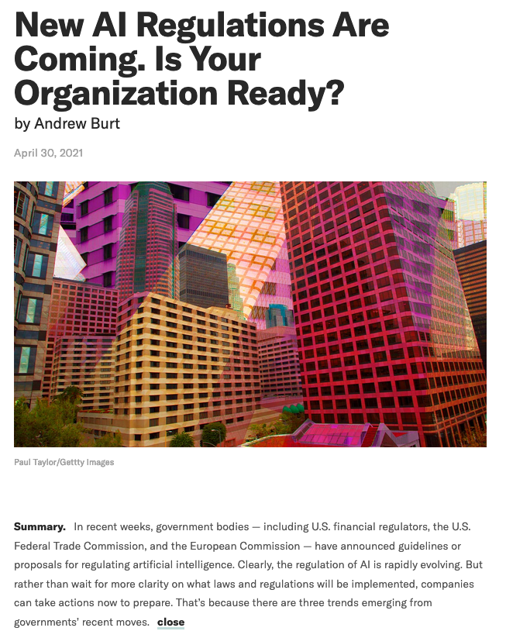

Regulation is Weak (so far…)
April 2021: President of the European Commission announces new EU rules for the use of Artificial Intelligence
https://hbr.org/2021/04/new-ai-regulations-are-coming-is-your-organization-ready

Slide 30
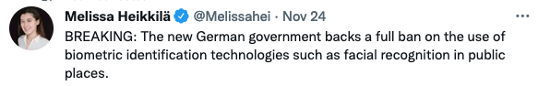

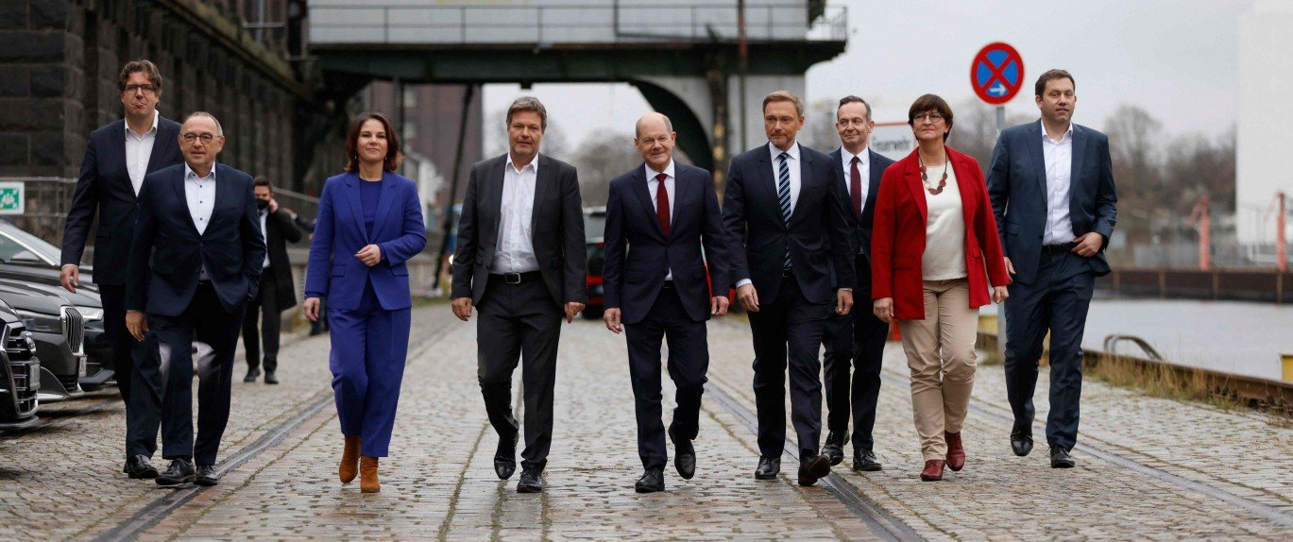
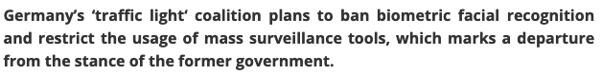
Some progress being made in AI-Reg
https://www.euractiv.com/section/data-protection/news/new-german-government-to-ban-facial-recognition-and-mass-surveillance/

Slide 31
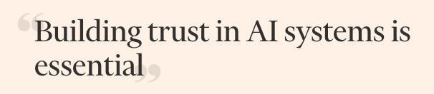

Recommendations to Build Trust in AI/ML
Teams that develop AI systems must be as diverse as possible to reduce the risk of bias.
Complex AI systems should never be deployed in any field unless they offer a demonstrable improvement on what already exists.
Algorithms that companies and governments deploy in sensitive areas such as healthcare, education, policing, justice and workplace monitoring should be subject to audit and comprehension by outside experts.
https://www.ft.com/content/85b0882e-3e93-42e7-8411-54f4e24c7f87

Slide 32
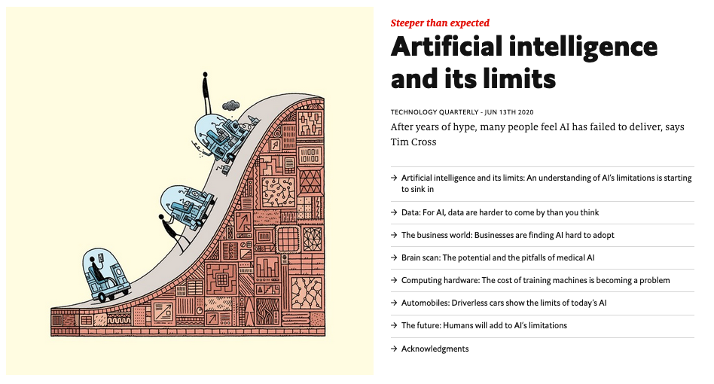
The Limits of AI
For a more complete picture on the limitations of AI and Machine Learning please read:
Economist Technology Quarterly
June 2020
https://www.economist.com/technology-quarterly/2020-06-13

Slide 33
PART C
The Future of AI/ML

Slide 34
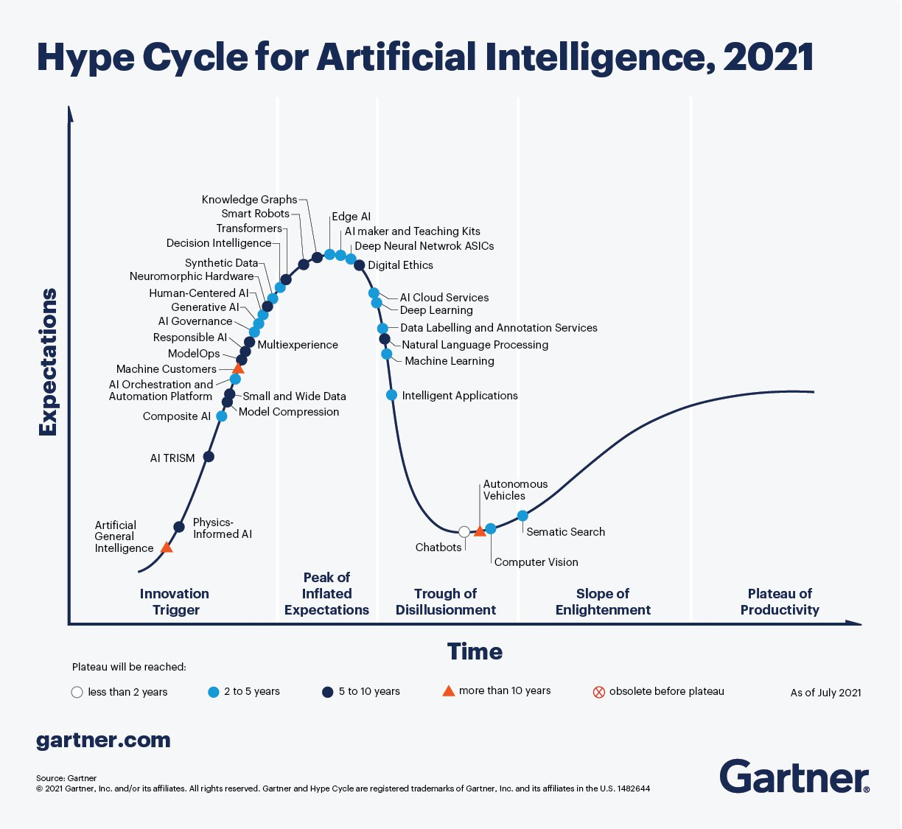


Slide 35
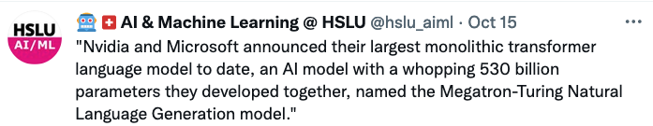
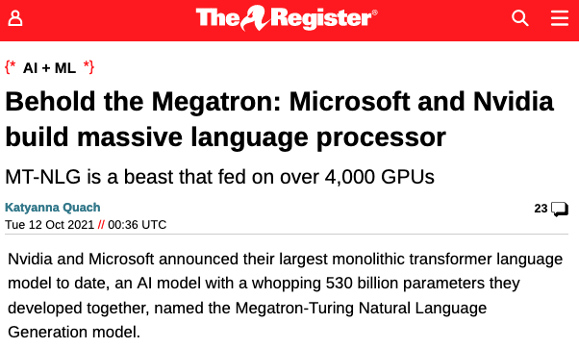
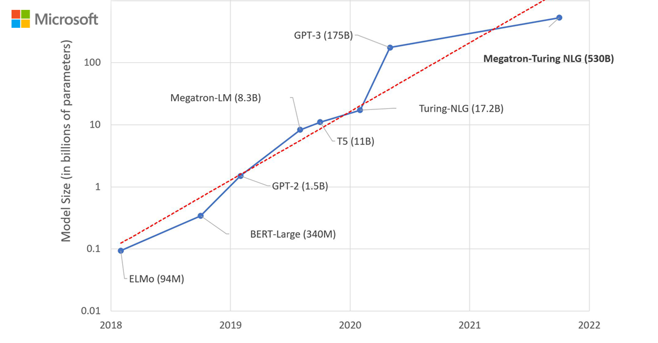
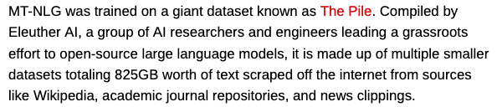
Models are Getting Bigger

Slide 36
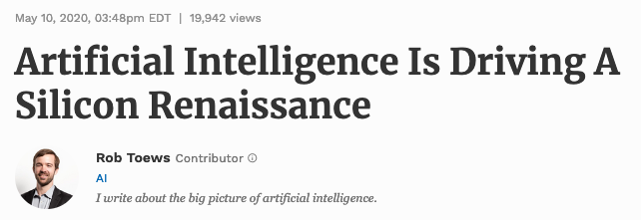
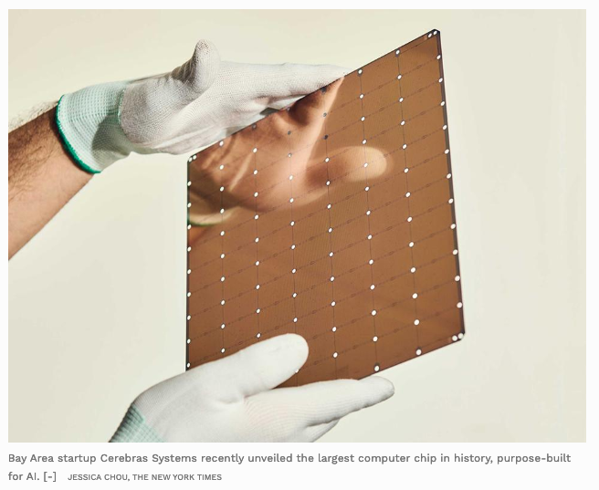
Custom Silicon for AI+Machine Learning
In recent years, a new crop of entrepreneurs and technologists has set out to reimagine the computer chip, optimizing it from the ground up in order to unlock the potential of AI.
GPUs are not optimized for an AI workload. The GPU has been adopted by the AI community, but it was not born for AI. Purpose built Hardware is the next frontier.
https://www.forbes.com/sites/robtoews/2020/05/10/artificial-intelligence-is-driving-a-silicon-renaissance/#7ffd4a99553c

Slide 37

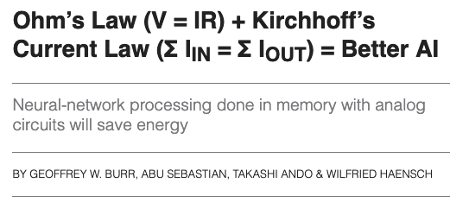


How to get even Bigger?
https://read.nxtbook.com/ieee/spectrum/spectrum_na_december_2021/ohm_s_law_kirchhoff_s_current.html

Slide 38

Explainable AI (XAI)
Many ML models are black boxes
We cannot explain the predictions they make
This is often the single biggest impediment to ML use in sensitive areas such as legal or medical applications
If we can couple the power of models such as deep learning, with the interpretability of models like decision trees, AI will become fundamentally ubiquitous
https://www.darpa.mil/program/explainable-artificial-intelligence

Slide 39


Data-Centric AI
https://twitter.com/AndrewYNg/status/1396922136808202241

Slide 40



Neuro-Symbolic AI
For most of AI history, symbolism has been the dominant approach.
But in the past decade, a revolution in neural networks has made deep learning the main workhorse.
The key to the next AI breakthrough might hinge on combining symbolist AI with neural networks.
https://bdtechtalks.com/2019/06/05/mit-ibm-hybrid-ai/

Slide 41



Modelling the Brain
https://twitter.com/jblefevre60/status/1467947563672293387

Slide 42


Brain-Machine Interfaces
Elon Musk launched Neuralink in 2016 with a half dozen researchers, professors and industry experts in 2016
It will eventually implant a computer chip, roughly the size of a large coin, into the human brain via a robot surgeon.
The chip, which Neuralink calls the “Link,” will wirelessly connect the brain to the digital world, starting by connecting to a smart phone.
The resulting computing power, according to Musk, will allow humans to be broadly competitive with rapidly developing AI.
https://www.cnbc.com/2020/12/05/elon-musks-neuralink-bold-ideas-hurdles.html

Slide 43

Artificial General Intelligence (AGI)
Narrow AI is a specific type of artificial intelligence in which a technology outperforms humans in some very narrowly defined task (what we covered in this module)
Artificial general intelligence (AGI), or “strong AI,” allows a machine to apply knowledge and skills in different contexts. This more closely mirrors human intelligence by providing opportunities for autonomous learning and problem-solving
https://medium.com/@selecticalinfotech/understanding-artificial-intelligence-3bdcde2993c3

Slide 44

Superintelligence
We don’t know exactly when developments in AI will translate into a machine that is generally intelligent — able to compete with, or surpass, humans in all mental tasks, from composing sonatas to planning a war.
But, fantastical as it seems, nothing in science seems to forbid the creation of such a machine. We know that blind evolutionary processes can produce human-level general intelligence, since they have already done so at least once.
In other words, unless you believe that there is something magical (as opposed to merely fiendishly complicated) about how the brain works, the existence of humans is proof, in principle at least, that intelligent machines can be built.
https://www.economist.com/books-and-arts/2014/08/09/clever-cogs

Slide 45
How Will Human Level AI Emerge?

Slide 46


The Singularity
Ray Kurzweil, a Director of Engineering at Google and pioneer of concepts related to the AI Singularity, forecasts that computers will have human level intelligence by 2029

Slide 47



What are the implications of AGI?
https://www.theguardian.com/books/2021/nov/29/the-big-idea-should-we-worry-about-artificial-intelligence?CMP=Share_iOSApp_Other

Slide 48
Thinking way into the Future!
Humans are always thinking about what the far future will look like
This is reflected in our culture, in literature, art, film and even music
Specific to AI and Machine Learning, there are many films which imagine a future world where machines have intelligence
Have you watched any of these? What do you think the future holds?
https://www.reddit.com/r/movies/comments/c0nkqt/oca_selective_timeline_of_famous_dystopias/

Slide 49



A More Realistic Look at the Future of AI/ML
https://www3.weforum.org/docs/WEF_Positive_AI_Economic_Futures_2021.pdf

Slide 50

Recap of Today’s Lecture
Latest Developments in AI/ML
Challenges & Risks in AI/ML
The Future of AI/ML?

Slide 51

Thank You! Any Questions?
Dr. Donnacha Daly
Head of Bachelor Program in Artificial Intelligence + Machine Learning
Member of the Algorithmic Business (ABIZ) Research Lab
Lucerne University of Applied Sciences and Arts
School of Computer Science and Information Technology
donnacha.daly@hslu.ch | hslu.ch/bachelor-ai | www.abiz.ch

